Slide 1

LLM Guided Search-and-Rescue with Reinforcement Learning
By
Farhan Mohammed
Raisulhaq Mohammed Rizwan
Muhammad Qasim

Slide 2
Outline
Problem Statement
Methodologies
Challenges
Results

Slide 3
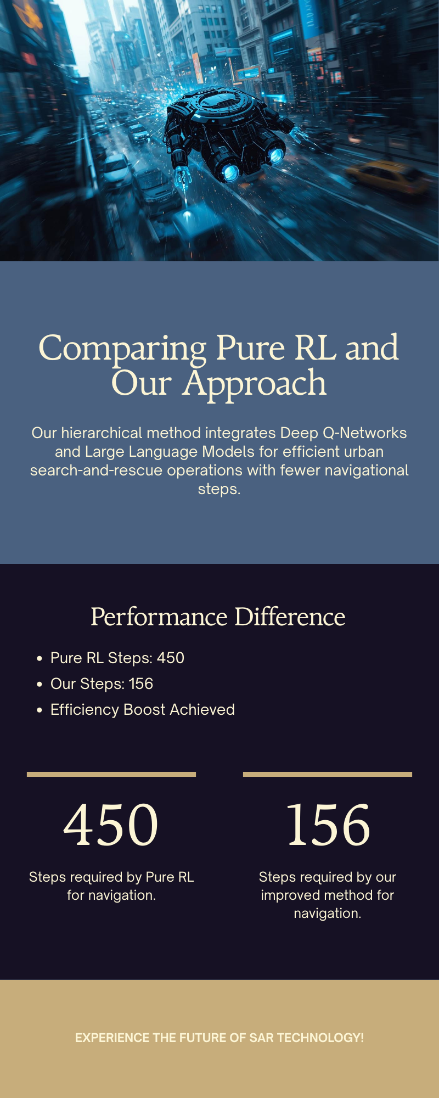
Introduction
Motivation
SAR in urban environments: Sparse rewards, obstacles, inefficient exploration, e.g., 45% success in pure RL.
Our Innovation: LLM as high-level waypoint planner + DQN for low-level navigation (RGB, LiDAR, direction vector).
Impact: Reduces unnecessary search by 50%, outperforms baselines in PyBullet sims.

Slide 4
Project Overview & Prerequisites
Task: Finite MDP for victim location in 3D urban sim (M = (S, A, P, R, γ, G)).
Prerequisites: Python/DL knowledge; PyBullet for sim; Transfer learning via pre-trained LLM.

Slide 5
Problem Formulation

Slide 6
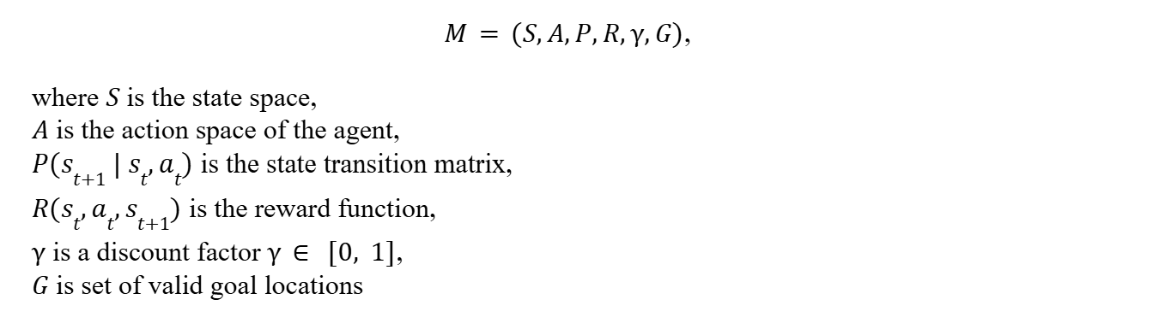
Search-and-Rescue Task

Slide 7
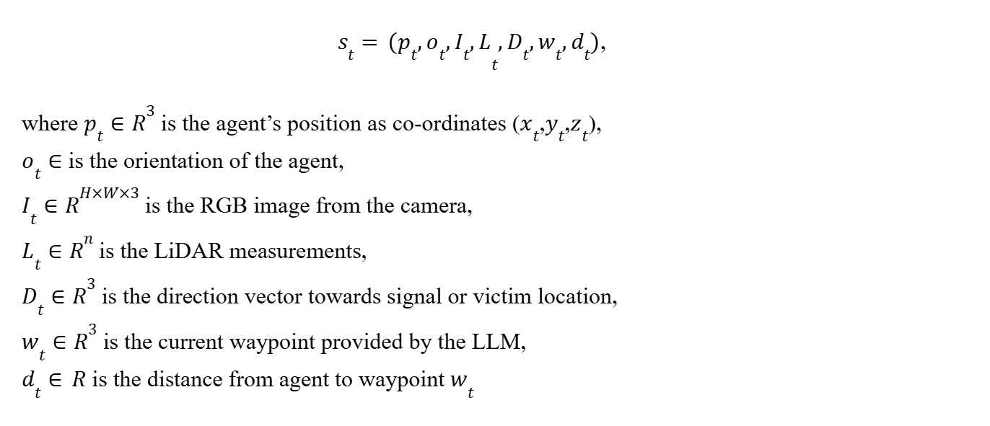
State Space

Slide 8
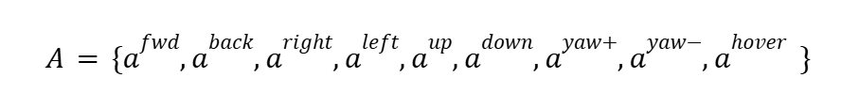
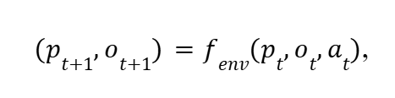
Action Space
Actions
Environment Transformation

Slide 9
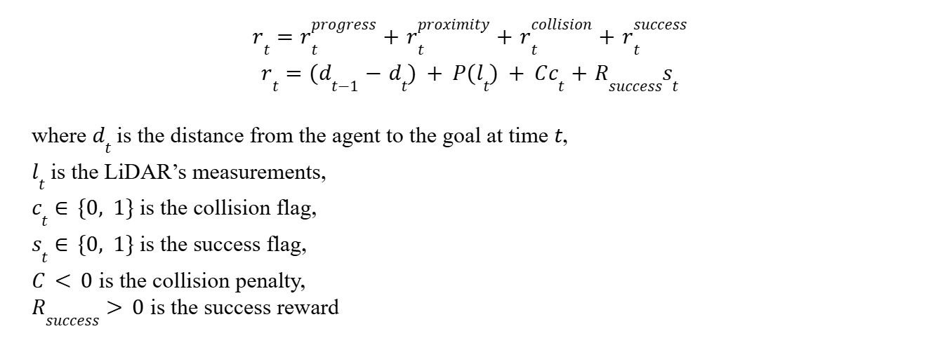
Reward Function

Slide 10
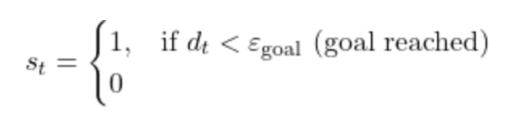
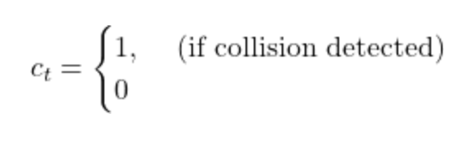
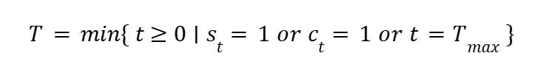
Termination Conditions
Mission Success
Collision
Timeout

Slide 11
System Architecture
and Methodologies

Slide 12
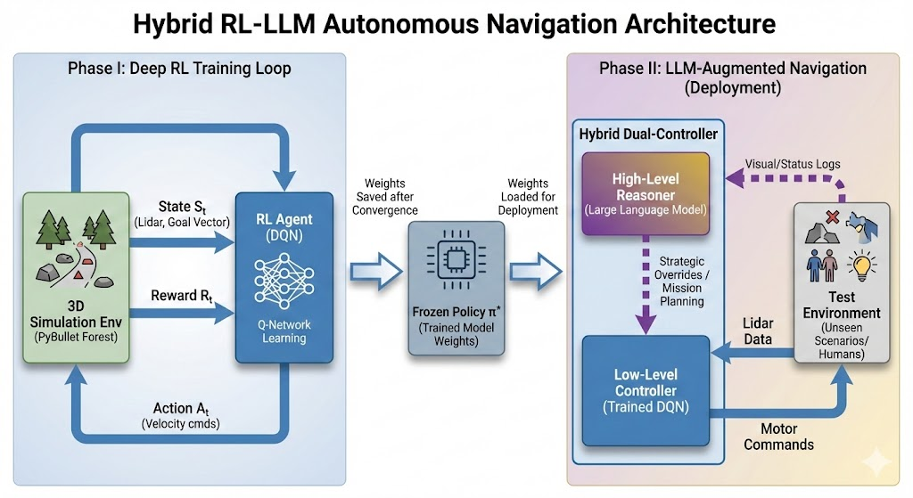

Slide 13
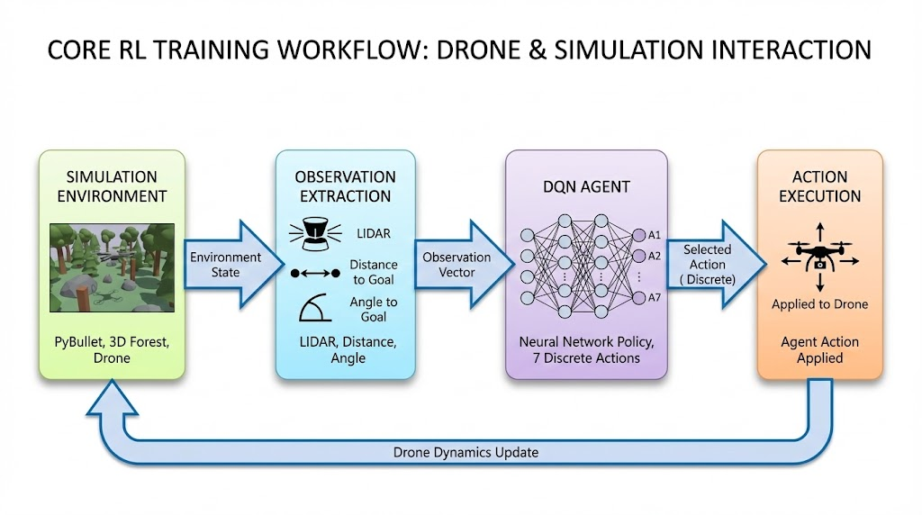

Slide 14
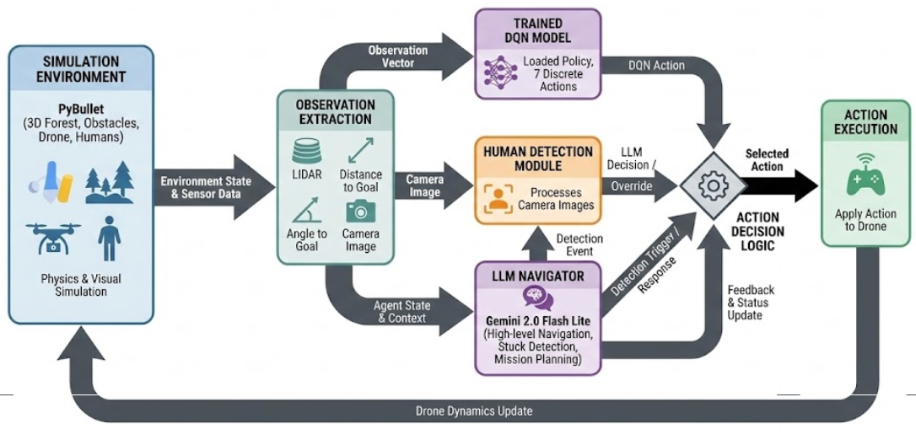
Workflow: RL, LLM, and Drone Interaction

Slide 15
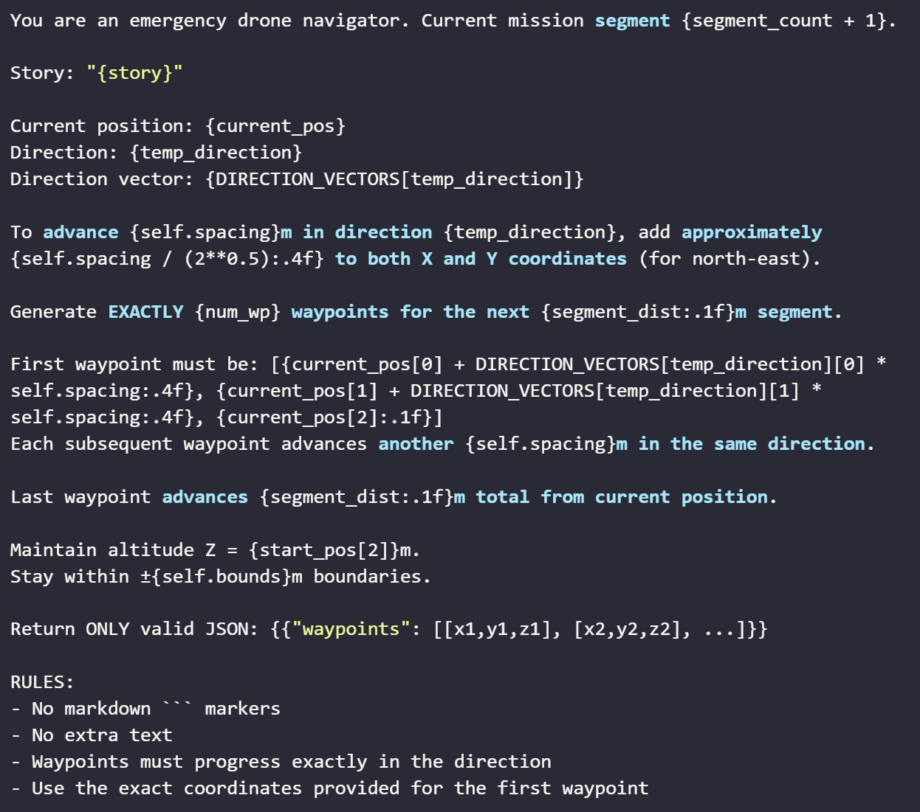
Segment Generation Prompt

Slide 16
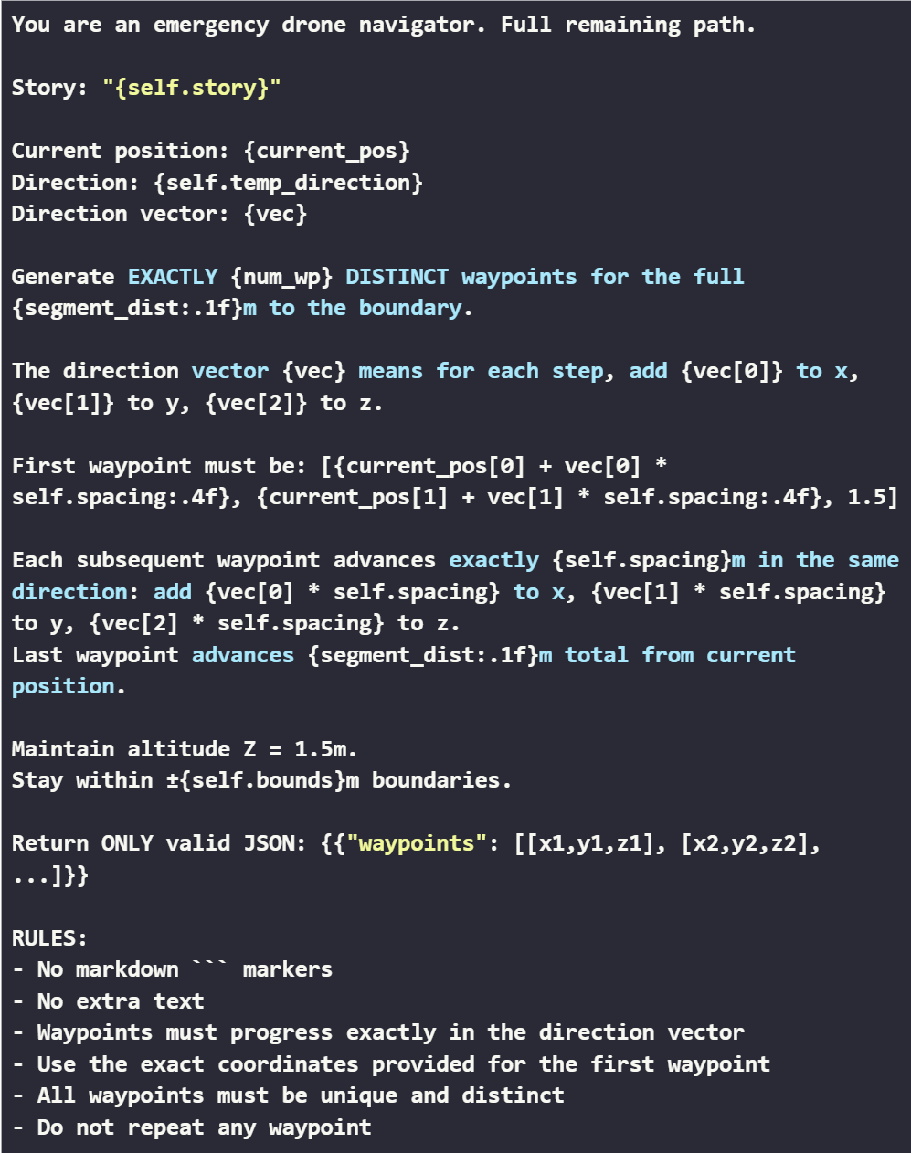
Waypoint Generation Prompt

Slide 17
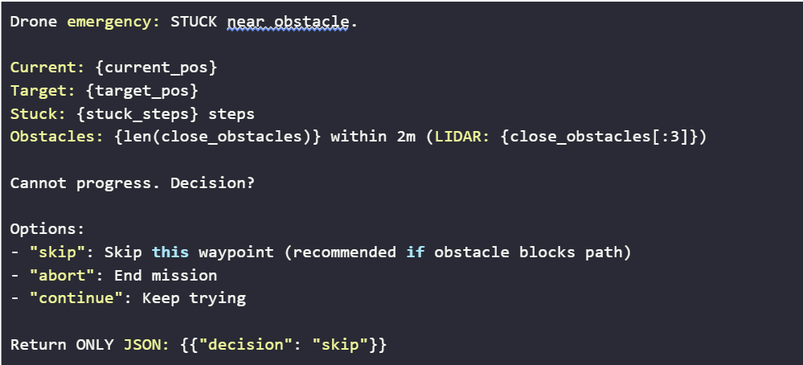
Stuck Resolution Prompt

Slide 18
System Execution Flow
Initialization & Planning
Load pre-trained DQN model + PyBullet GUI environment
Accept natural language mission story (e.g., "Emergency beacon north-east")
LLM extracts direction → calculates boundary target
Generate waypoint path with exploration pattern (LEFT → CENTER → RIGHT → CENTER)
Navigation Loop
DQN predicts actions from observations (36-ray LIDAR + waypoint distance/angle)
Execute discrete actions: hover, ±X, ±Y, ±Z
Camera captures frames for human detection (magenta color + shape validation)
Real-time visualization: LIDAR overlay, path trail, waypoint markers

Slide 19
Intelligence and Mission Completion
Adaptive Decision Making
Stuck Detection: Monitor progress → consult LLM after 1000 steps
LLM Intervention: Analyzes LIDAR + position → decides CONTINUE/SKIP/ABORT
Dynamic Planning: Request new waypoint segments as needed
Mission Success Criteria
Reach boundary target (<2m threshold)
Detect human (if required) → save snapshot + coordinates
Complete all exploration waypoints

Slide 20
Results and Analysis

Slide 21
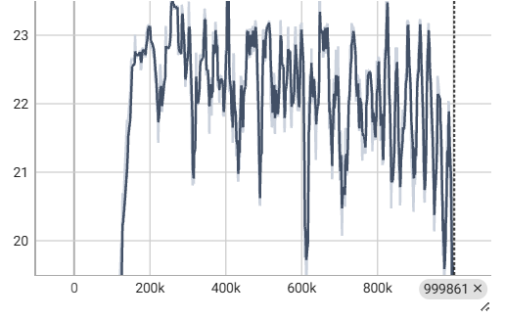
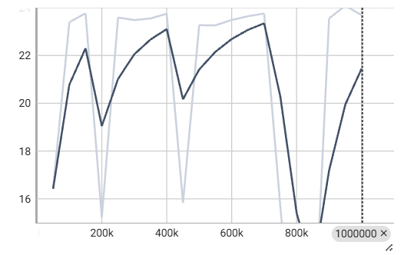
Rewards vs Episode
Rollout Reward
Evaluation Reward

Slide 22
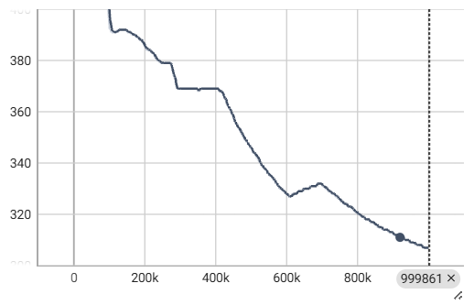
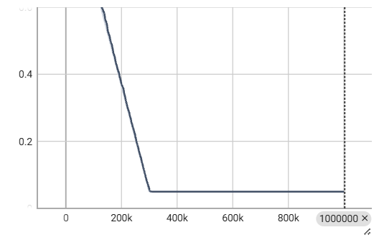
Scalars per Step
FPS
Exploration Rate

Slide 23
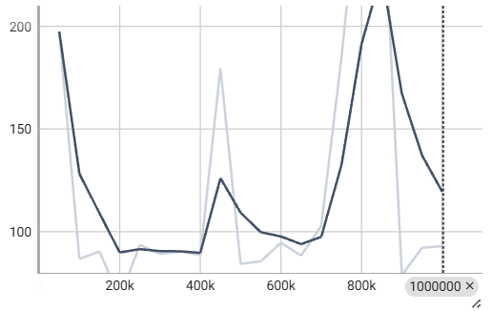
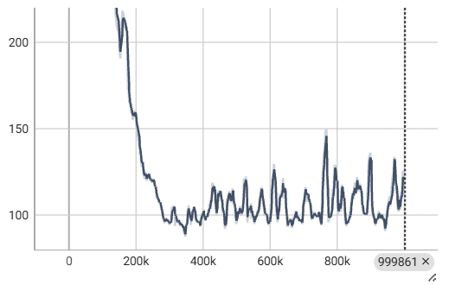
Scalars per Step
Rollout Episode length mean
Eval Episode length mean

Slide 24
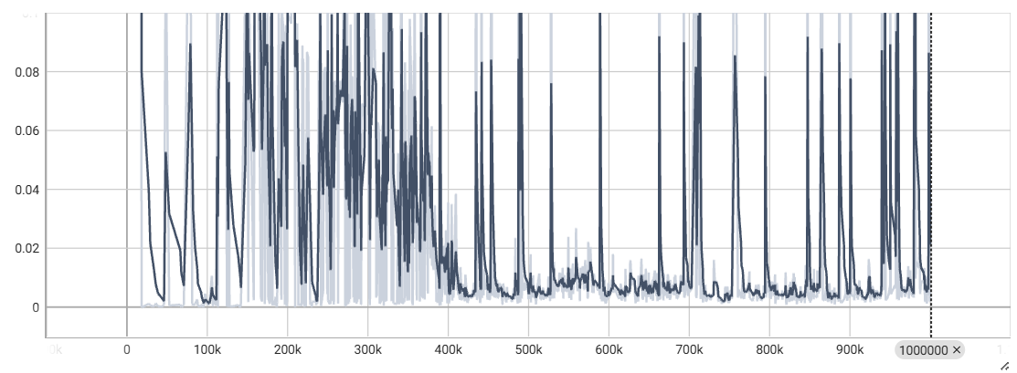
Scalars per Step
Train/Loss

Slide 25
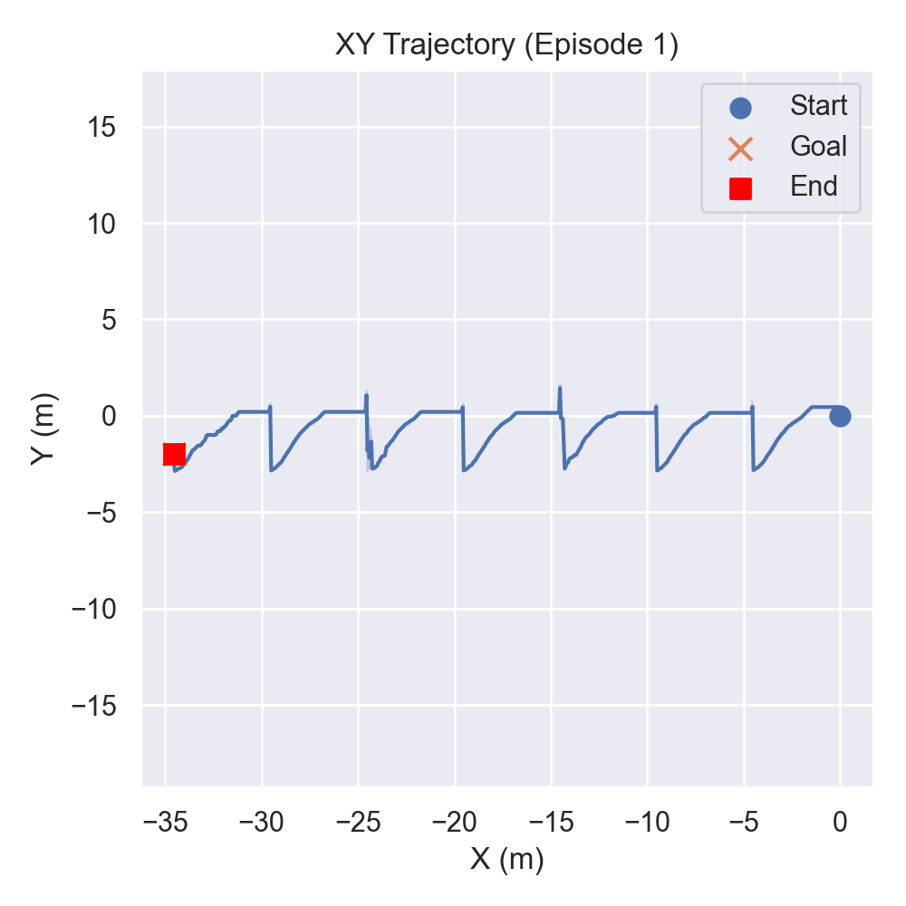
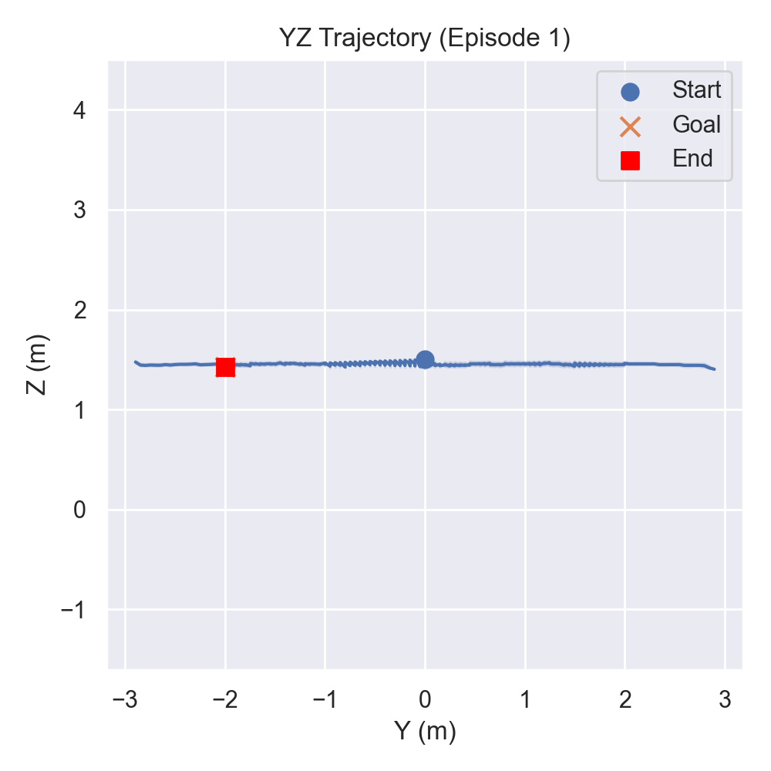
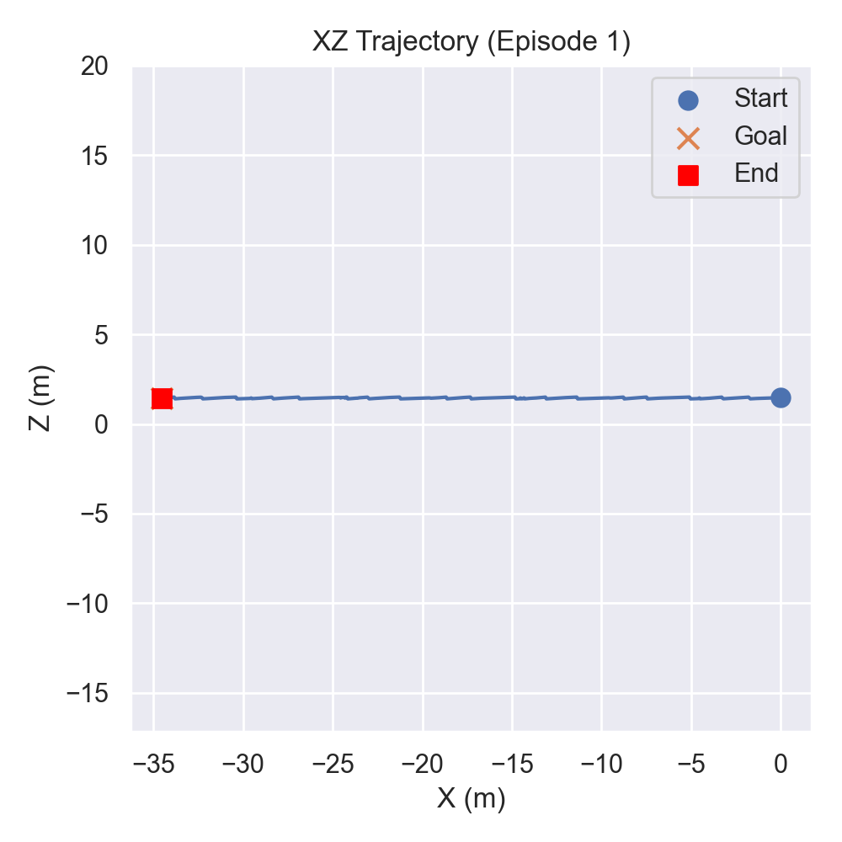
Trajectory Plots

Slide 26
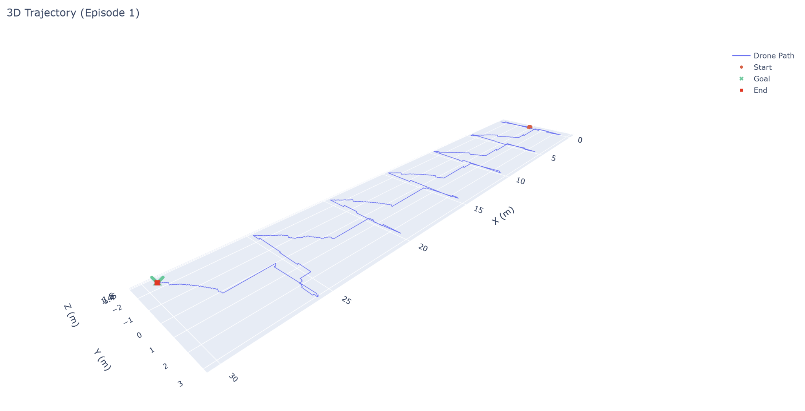
Trajectory Plots

Slide 27
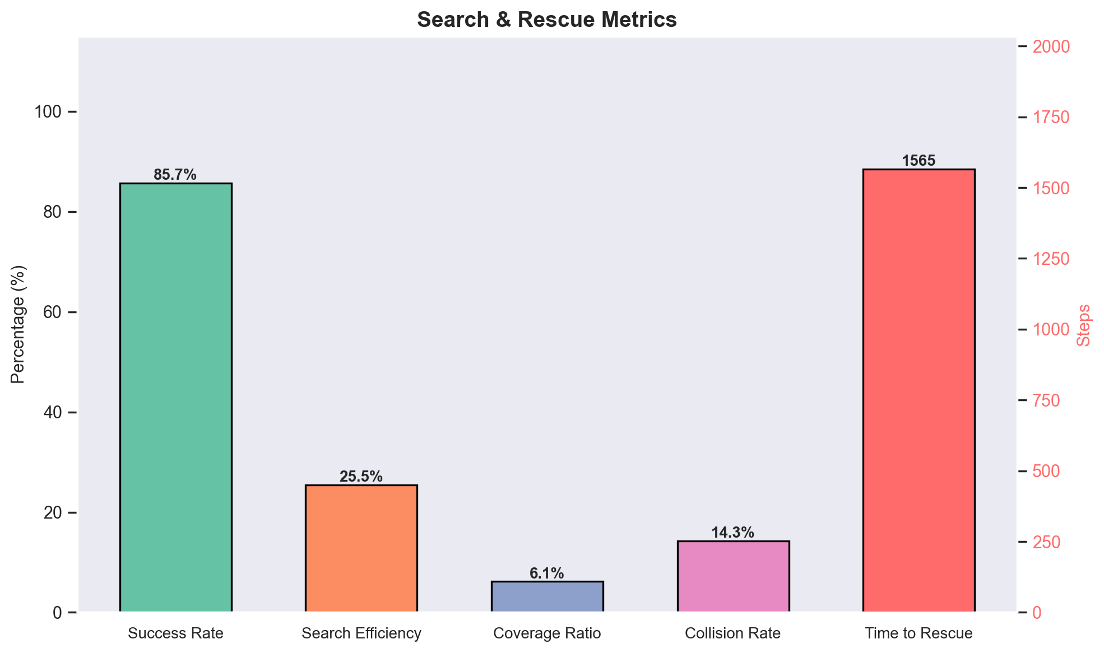
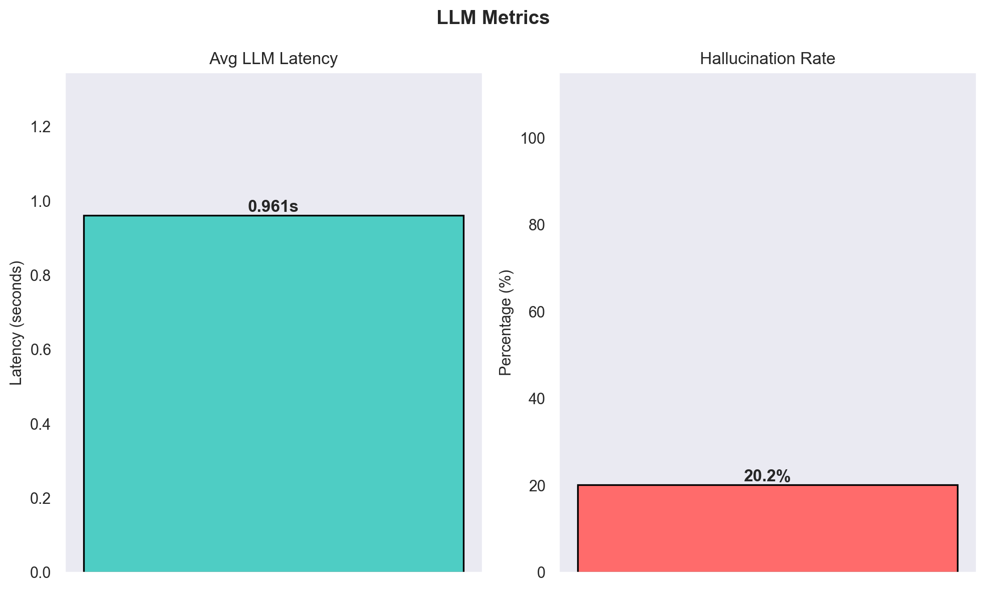
Evaluation Metrics

Slide 28
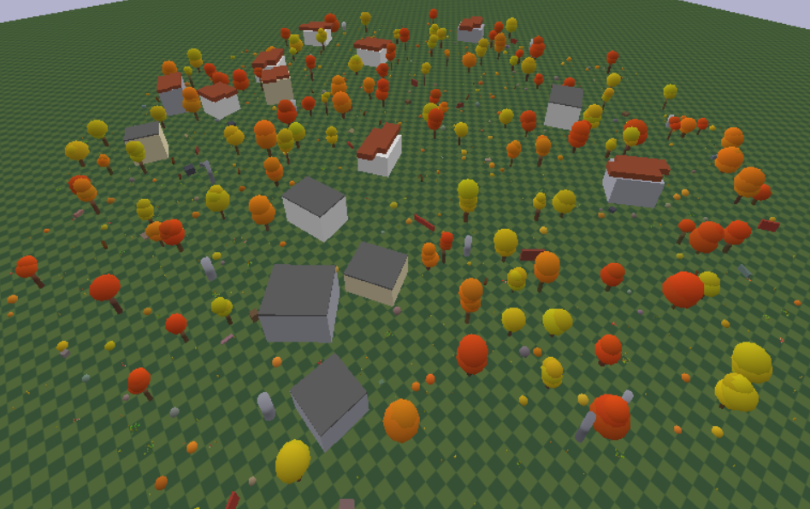
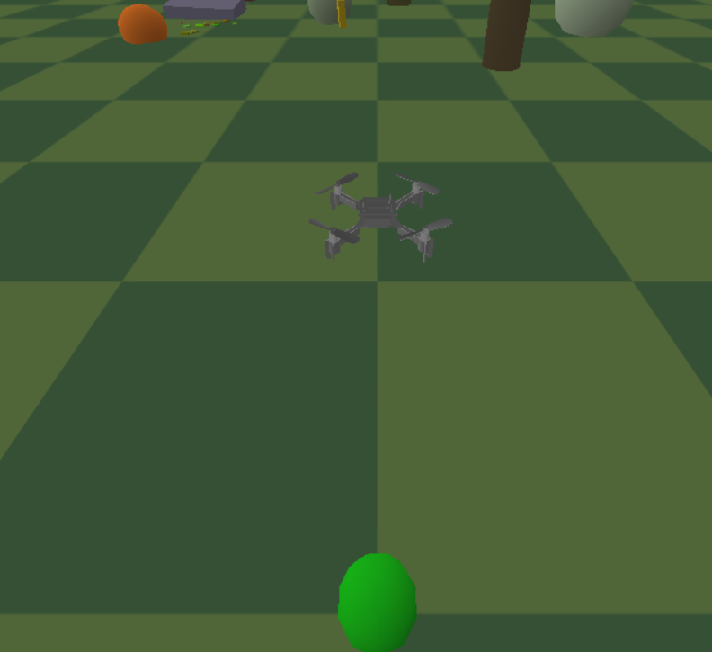
Environment

Slide 29
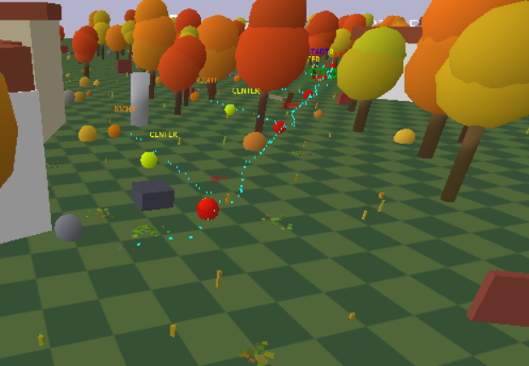
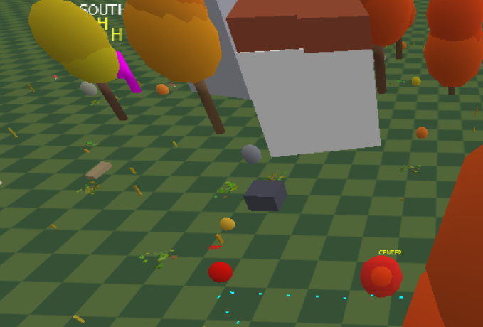
Drone Navigation

Slide 30
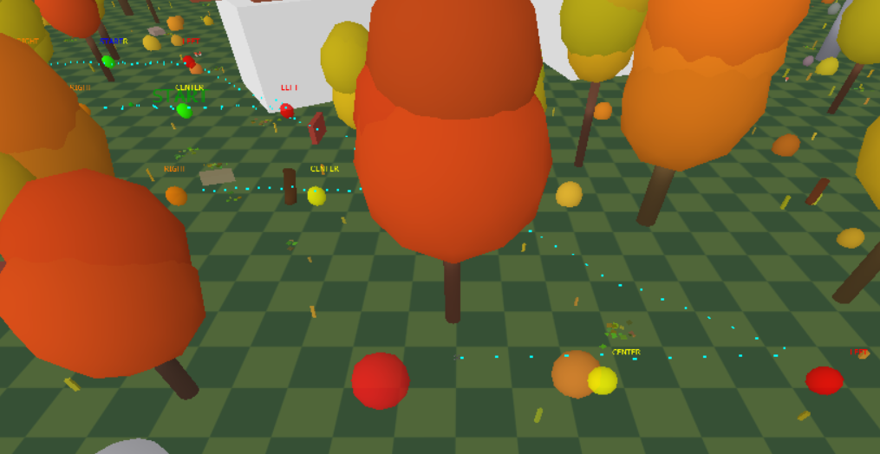
Drone Navigation

Slide 31
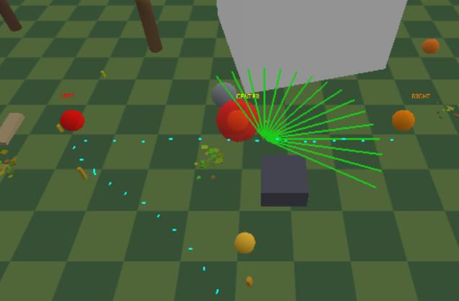
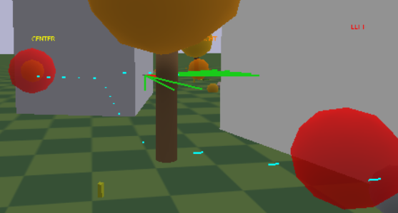
LiDAR Scanning

Slide 32
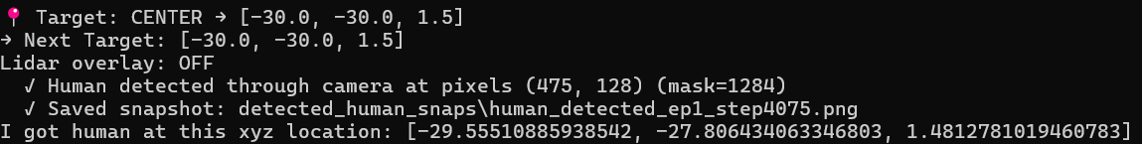
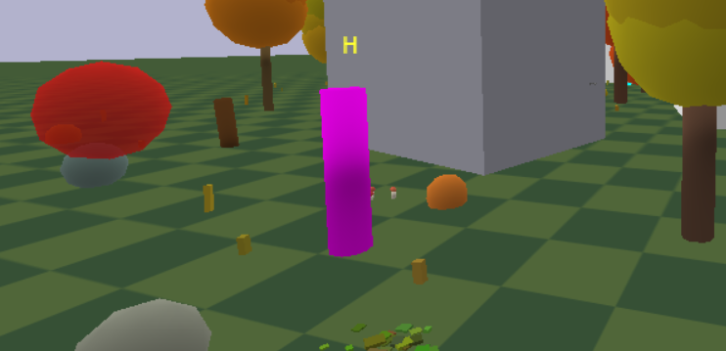
Mission Success

Slide 33
What Have We Learnt
Key Insight: LLM hierarchies solve RL sparsity and waypoints make exploration 50% more efficient.
Technical Lessons: Prompt engineering > model size for robotics; Multi-modal fusion needs careful normalization.
Broader Impact: Scalable to real UAVs (e.g., AirSim transfer); Ethical: Bias in LLM urban assumptions.
Future Work: Multi-agent SAR; Real-time hardware via ROS integration.

